Slide 1

IPL Player Recommendation and Performance Prediction
Exploring how machine learning can enhance player selection and performance forecasting for the Indian Premier League.

Slide 2
Overview of IPL Dataset
Key Batsman Metrics
Key Bowler Metrics
Team Summary Metrics
Runs Scored, Balls Faced, batting average, strike rate, Fours and Sixes Hit
Overs Bowled, Maiden Overs, Runs Conceded, Wickets Taken, Economy Rate
Away Team, Home Team, Scores by Both Teams, Wickets Taken by Both Teams

Slide 3

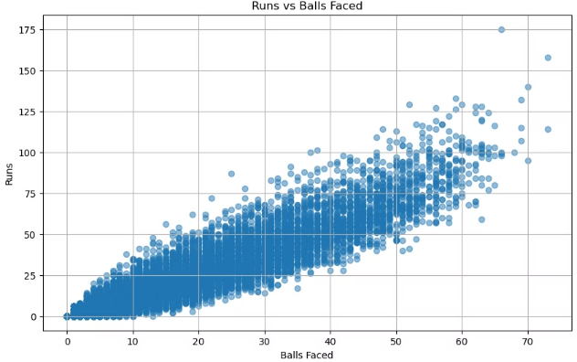
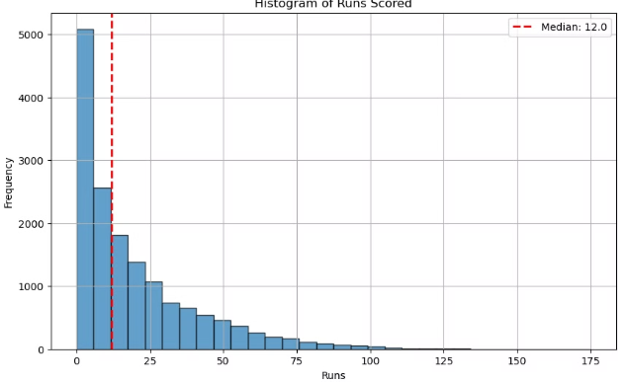
Exploratory Data Analysis of Batting Data
Positive Correlation between Runs Scored vs Balls Faced
Most Batsman Score less than 20runs in an innings individually

Slide 4

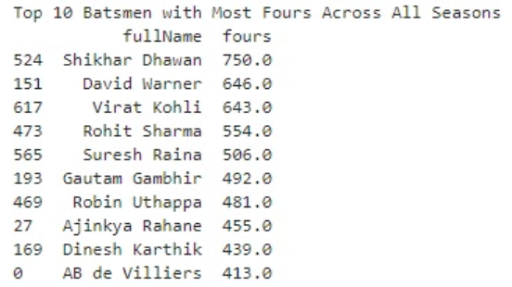
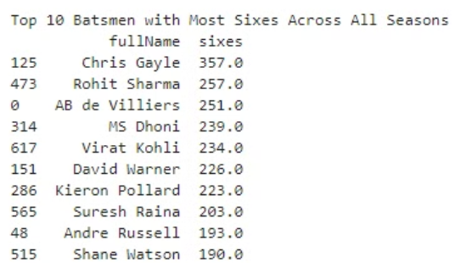
Exploratory Data Analysis of Batting Data
Top consistent batters like Virat Kohli, Suresh Raina, Rohit Sharma and AB de Villiers can be seen to be top in both batsmen with the most fours and sixes overall. These players have demonstrated their ability to consistently score boundaries, which is a key indicator of their batting prowess and ability to dominate the opposition bowling attacks.

Slide 5

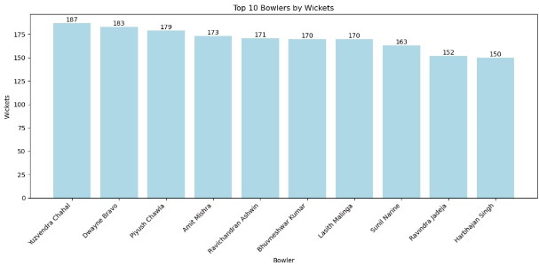
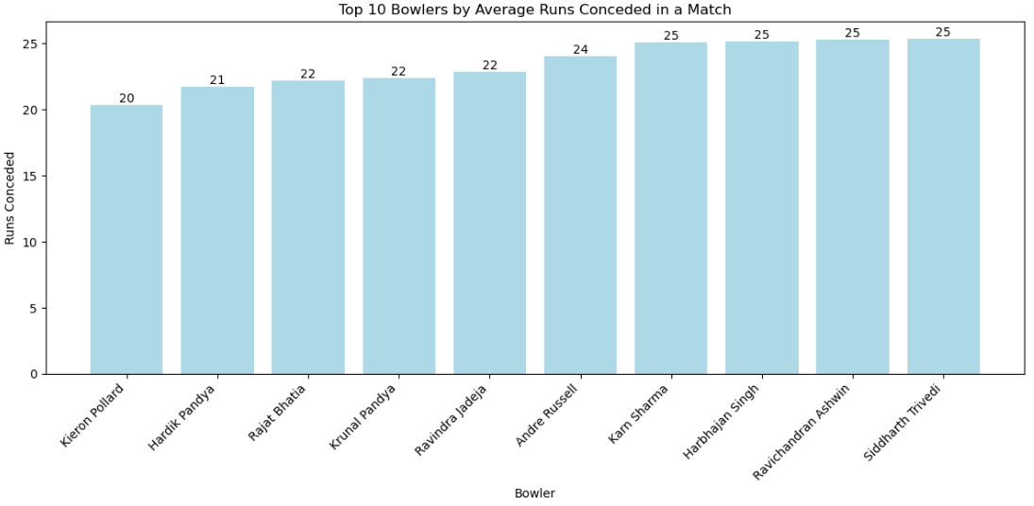
Exploratory Data Analysis of Bowling Data
Most of the Bowlers in highest wicket takers are Spinners.
Most of the top bowlers with less runs conceded in a match are Spinners.

Slide 6

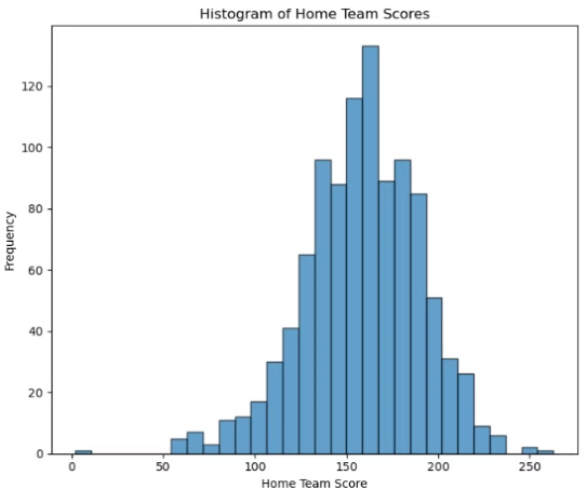
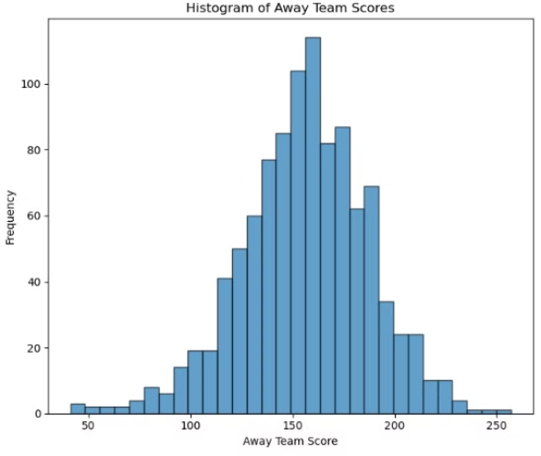
Exploratory Data Analysis of Team Scores
Most of the matches see the Home Team Scoring between 140 to 170 runs
Most of the matches see the Away Team Scoring between 130 to 180 runs

Slide 7

Player Recommendation Using Machine Learning
1
Feature Engineering
2
KMeans Clustering
3
Evaluation and Validation
Selecting the most relevant player statistics and performance metrics
Grouping players with similar characteristics to identify potential replacement
Assessing the accuracy and effectiveness of the recommendation system

Slide 8


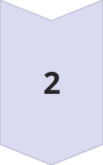

Feature Engineering and Data Preprocessing
Data Cleaning
Handling missing values
Feature Selection
Identify the most relevant variables for the model - Runs Scored, Wickets Taken, Boundaries Hit, Runs Conceded etc.
Feature Engineering
Create new features from the existing data - Average Strike Rate, Average Economy Rate etc.

Slide 9

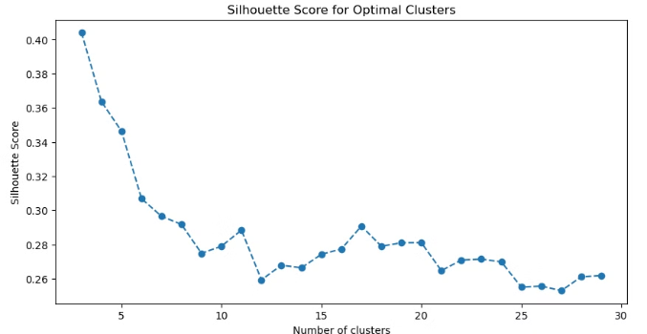
Silhouette Score for K-Means Clustering
The Silhouette Coefficient scores the clustering pattern highly if groups are compact and well-separated. The Silhouette Score keeps on decreasing from cluster number 3 which indicates that the number of clusters should be kept as 3 for the given dataset.

Slide 10

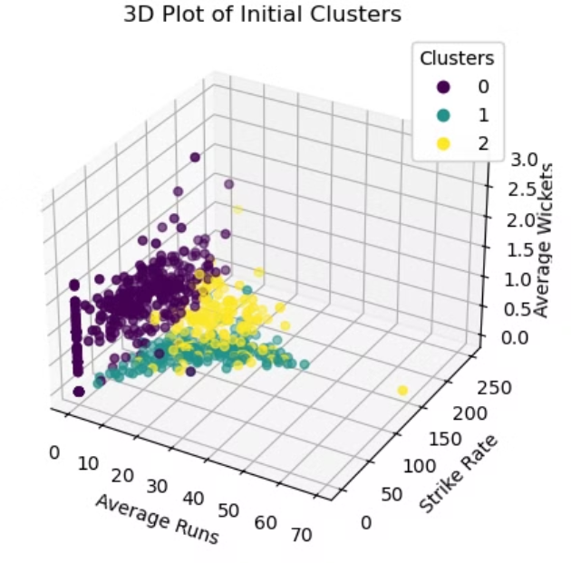
Visualizing Initial Player Cluster

Slide 11
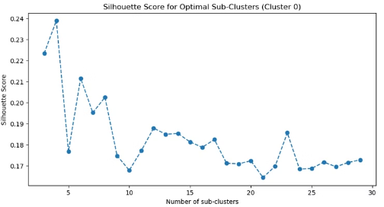
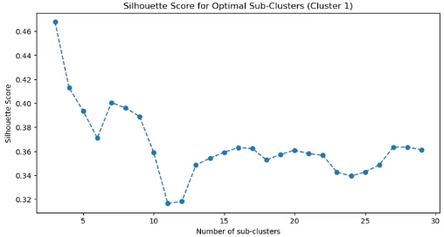
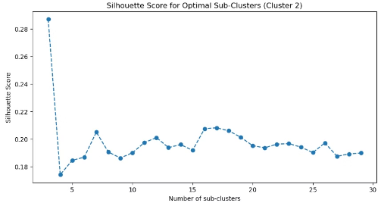
Sub Clusters for Each Cluster
Using these subclusters we can recommend replacement players
during the start of each season

Slide 12

Predicting Player Performance with Neural Networks
To help optimize team selection and strategy, we have developed two neural network models to predict key player performance metrics:
Batsman Scoring Prediction: This model uses an artificial neural network to predict whether a batsman will score more than 30 runs in their next match. It takes in features like previous match scores, strike rate, and other batting statistics to make this prediction.
Bowler Wicket Prediction: The second model focuses on predicting whether a bowler will take at least 1 wicket in their next match. Similar to the batting model, it leverages the bowler's historical performance data to forecast their upcoming results.

Slide 13

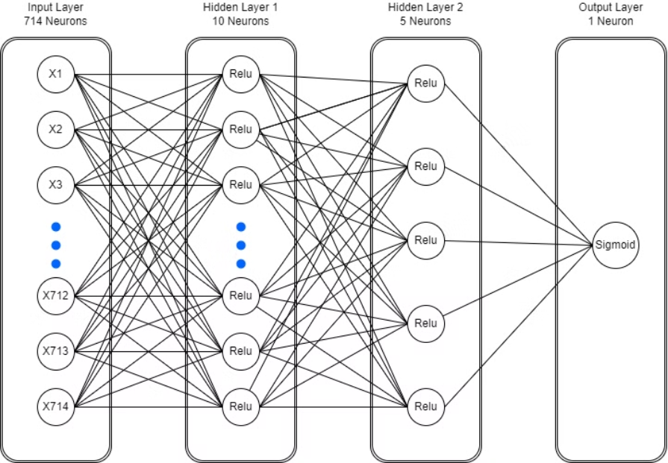
Neural Network For Batsman Perfomance Prediction

Slide 14

Model Classification Report
Precision
Recall
F1-Score
Batsman Less Than Scoring 30 Runs
0.91
0.92
0.91
Batsman Scoring More Than 30 Runs
0.67
0.64
0.65
The model's classification report shows performance, with an accuracy of 86% and a balanced F1-score of 0.78.

Slide 15

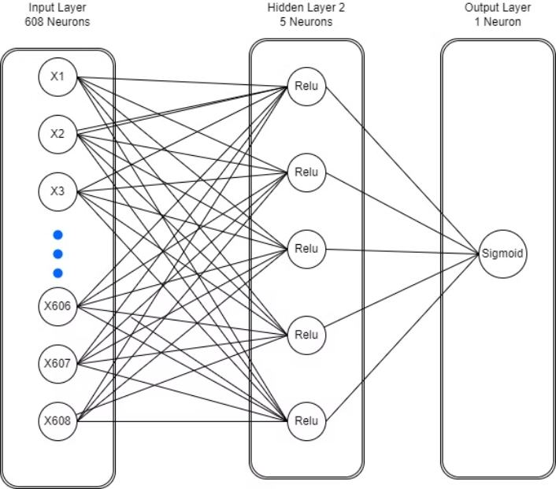
Neural Network for Bowler Performance Prediction

Slide 16

Model Classification Report
Precision
Recall
F1-Score
Bowler taking no wickets
0.42
0.40
0.41
Bowler taking at least 1 wicket
0.52
0.55
0.54
The model's classification report shows performance, with an accuracy of 48% and a balanced F1-score of 0.47.

Slide 17
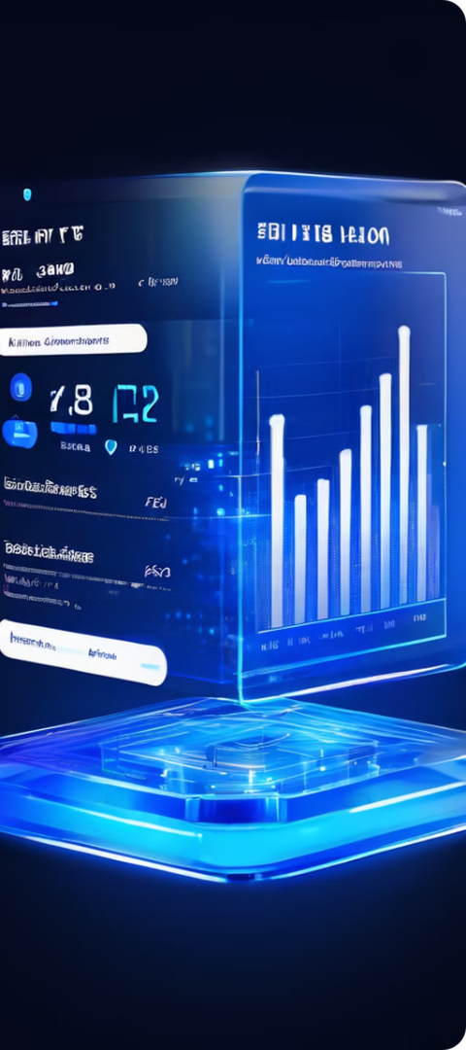
Conclusion and Future Directions
Key Takeaways
Potential Improvements
Machine learning can significantly enhance player selection and performance forecasting
Incorporating more player and match context, real-time data, and advanced techniques
Future Applications
Player trading and strategy optimization

